Slide 1
Threads, Runnables, and Executors
James Kennedy

Slide 2
Threads
The thing

Slide 3
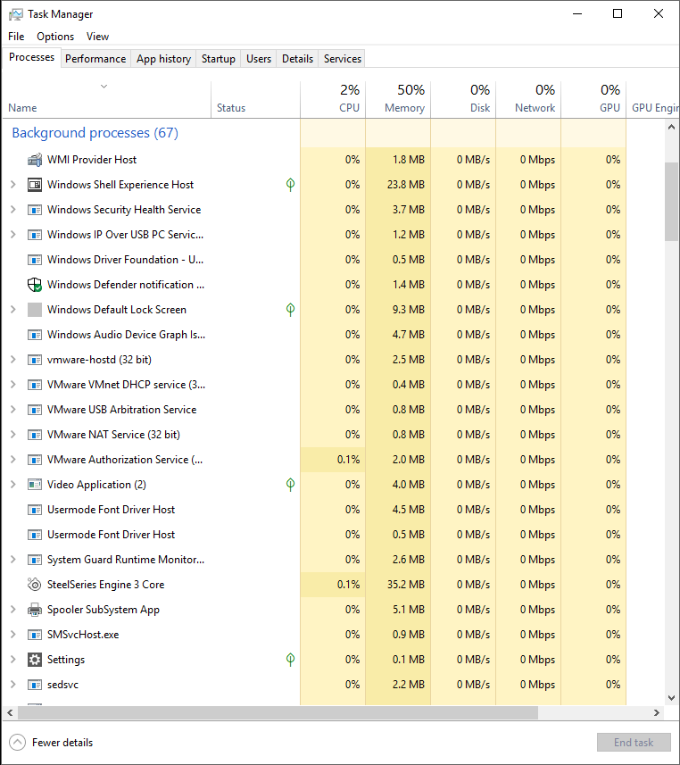
Threads
Similar to the Processes in Windows Task Manager
In essence, a task which is being completed
Multiple can be running simultaneously
Priority according to time created by default.

Slide 4
Runnables
The Enabler

Slide 5
Runnables
A Java Interface “implemented by any class whose instances are intended to be executed by a thread.”
Must implement run() method
In essence, what makes a class able to be “run,” hence the name.

Slide 6
executors
The manager

Slide 7
Executors
This is the interface which enables automated Thread creation for execution of Runnables.
Subinterface ExecutorService has access to more methods, such as those which govern process termination.
Can be turned on and off, preventing tasks from starting
Similar to the Task Manager itself.

Slide 8
Live Demo Time

Slide 9
The End

